Slide 1
PC-Builder
Members: Hriday Keswani (2003088) Viren Keswani (2003089) Atharva Kadam (2003075) Supervisor: Ms. Manisha Dumbre

Slide 2
Introduction
We are working on a website that helps people build their custom personal computers
<number>

Slide 3
Aim and Objective
Aim:
To build a website for all in one resources for helping people build custom personal computers Objective:
To help people get the correct build configurations for their work-case and prevent them from overspending on components.
<number>

Slide 4
Scope
This project wil be a website, that would include various pre-built PCs catering different work-cases. The webiste will also include a guide on how to get started building a pc and explaination for first timers.
<number>

Slide 5
Literature Review
The existing websites for building personal computer are mostly e-commerce websites with the aim to sell their most profitable build which compromises the best interests of the end buyer who has little knowledge on the right components as per their requirements, some exisisting websites are: - NZXT - MD Computers - Amazon - Prime ABGB
<number>

Slide 6
Problem Statement
PC building may seem overhwleming, especially for first timers and many people often end up spending more than required and often end up buying incompatible parts
<number>

Slide 7
The pandemic caused deep problems in the semi-conductor supply chain leading to a huge shortage of chips which is contradicting to the sudden hike in demand for the very same semiconductors leading to highly overpriced components put forth by third part sellers (known as scalpers).
<number>

Slide 8
These Scalpers block the official sellers by buying the launched chips before a common consumer can buy and resell them at exponentially higher prices.
<number>

Slide 9
When the ongoing scalping and lack of information has lead to the ill-informed consumers buying overpriced components there by getting less than what they pay for.
<number>

Slide 10
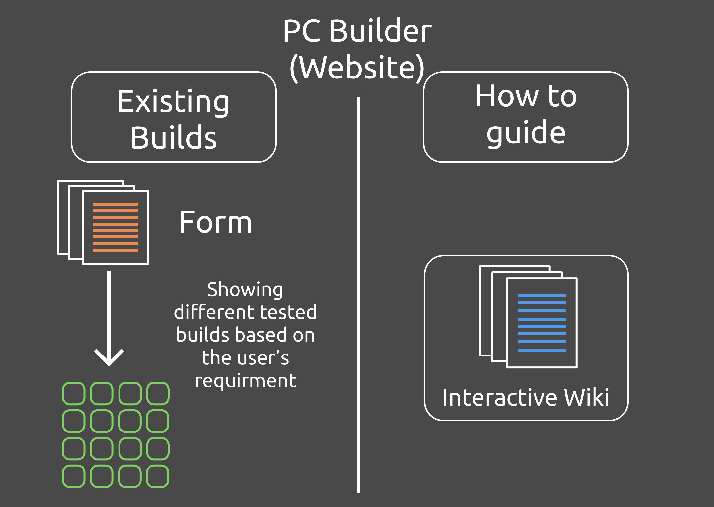
Website Architecture
<number>

Slide 11
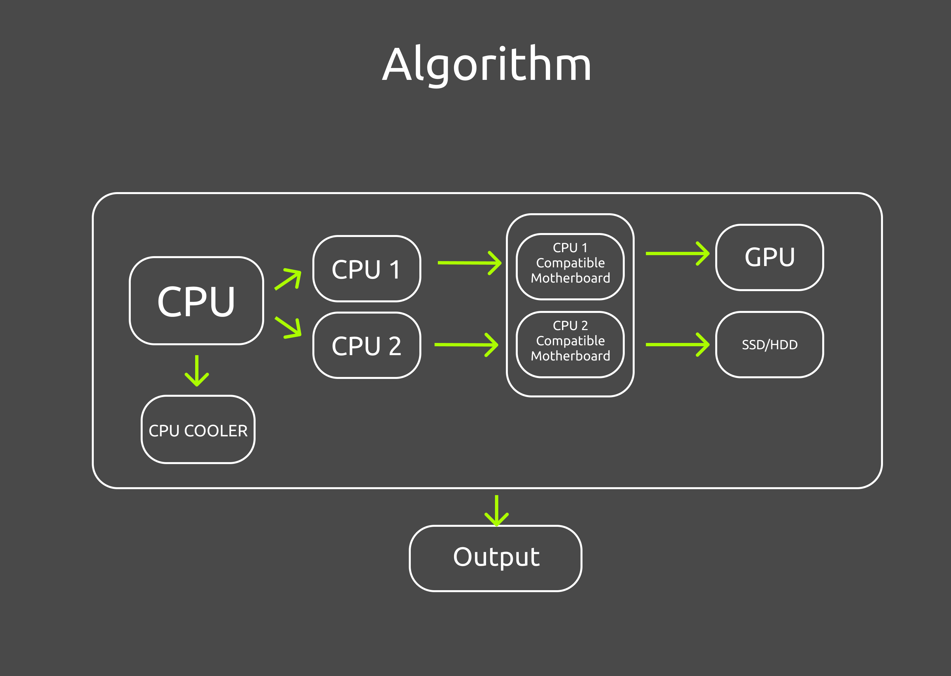
Working of Website
<number>

Slide 12
Technologies Used
- HTML/CSS - Javascript - Node.js - Express - Python (for getting data on components via api)
<number>

Slide 13
Requirments
- A system capable of rendering modern websites - Internet connection
<number>

Slide 14
References
- pcpartpicker
- NZXT
- MD computers
- ibuy-power
<number>

